Slide 1

itsfolio.tech
STUDENT CREDENTIALS
Lavanya Jangid
Enrollment / Roll No.
Program & Semester
SOFTWARE DEVELOPMENT INTERNSHIP
2410031445
B.Tech (CSE)
Software Development & AI Integration
A 6-Week Professional Internship Presentation Report
HOST ORGANIZATION
INTERNSHIP DURATION
itsfolio.tech
June 18 – July 31, 2026 (6 Weeks) • Remote
From resume to portfolio — instantly

Slide 2
Candidate & Program Overview
Candidate Details
Internship Profile
Student Name: LAVANYA JANGID Roll Number: 2410031445 Degree: B.Tech (Computer Science & Engineering) Academic Batch: 2026-2027 University: IILM University, Greater Noida, U.P.
Position: Software Development Intern Organization: itsfolio.tech Duration: 6 Weeks (June 18 – July 31, 2026) Work Mode: Remote Compensation: Certificate of Internship & LOR on completion

Slide 3
Organization Profile: itsfolio.tech
itsfolio.tech is an AI-powered platform that turns resumes into hosted, recruiter-ready portfolio websites in seconds, built around the vision "From resume to portfolio — instantly".
Growth in first two months since launch
Founder-Led Product: Founded by Mr. Ashish Umrao; interns collaborate directly with the founder on product, backend, and AI-integration tasks.
3,000+
Visitors
AI at the Core: Automatically parses an uploaded resume and generates a polished, hosted personal portfolio website within seconds.
500+
Monthly Active Users
Startup Environment: A fast-shipping, early-stage startup offering exposure to the full lifecycle — from code to ship to user feedback.
800+
Portfolios Generated

Slide 4
Problem Statement & Industry Context
The Industry Challenge
The Internship Scope
Students and early-career professionals struggle to present their skills effectively to recruiters. Almost everyone has a resume, but very few have a personal portfolio website — building one traditionally demands design skill, web development knowledge, hosting setup, and significant time.
Contribute to the live itsfolio.tech platform as a software developer: hands-on development on the Next.js/React codebase, shipping real features to real users, and strengthening the backend and AI pipeline.
A strong resume sitting as a static PDF provides far less recruiter impact than a live, polished, shareable portfolio website.
Collaborating directly with the founder on product, backend, and AI-integration tasks in a fast-moving startup environment.

Slide 5
Core Internship Objectives
</>
{ }
AI
🚀
Frontend Development
Backend & APIs
AI Integration
Startup Lifecycle
Ship real, user-facing features on the live Next.js/React platform — components, portfolio templates, and responsive UI improvements.
Build and improve Next.js API routes and server-side logic powering the resume upload and portfolio generation pipeline.
Work on LLM-powered resume parsing and portfolio content generation — prompt design, structured outputs, and quality improvements.
Experience the full lifecycle of a growing startup — from code to ship to user feedback — with founder-level collaboration.

Slide 6
Technologies & Development Toolchain
1
2
3
4
Frontend
Backend
AI & GenAI
DevOps & Workflow
Framework: Next.js, React Languages: JavaScript / TypeScript, HTML, CSS UI: Responsive, utility-first styling
Runtime: Node.js APIs: Next.js API routes, RESTful services Data: Cloud database & file storage
Core: LLM APIs for resume parsing & content generation Practice: Prompt engineering, structured outputs
Versioning: Git, GitHub, code reviews Deployment: Cloud hosting for the live app Process: Async updates, agile shipping

Slide 7
Platform Architecture
User • Web Browser
Presentation Layer: Next.js/React web app where users upload resumes and manage their hosted portfolio.
▼
Next.js / React Frontend
API Layer: Next.js API routes and server-side logic handling uploads and generation requests.
▼
API Routes (Node.js)
AI Processing Layer: LLM services that parse resumes and generate polished portfolio content.
▼
AI Resume Parsing & Generation (LLM)
Data Layer: Databases and storage for accounts, resume data, and portfolio configurations.
▼
Database & Storage
Hosting & Delivery: Cloud infrastructure serving each portfolio as a fast, public, recruiter-ready site.
▼
Feedback Layer: Analytics on visitors and generation that drive product iteration.
Hosted Portfolio Sites

Slide 8
Internship Timeline (Weeks 1 to 3)
Week 2
Frontend Features
React components, portfolio templates, responsive UI polish shipped to the live platform.
Week 1
Week 3
Onboarding & Codebase
Backend & APIs
Product roadmap, dev environment setup, Next.js/React codebase walkthrough, Git workflow.
API routes, resume upload & processing pipeline, data modelling and integration.

Slide 9
Internship Timeline (Weeks 4 to 6)
Week 5
Testing & Deployment
Bug fixes, feature testing, deployment workflow, performance & SEO optimization.
Week 4
Week 6
AI Integration
Feedback & Delivery
LLM-based resume parsing & content generation, prompt design, structured outputs.
User feedback iteration, analytics, documentation, and final handover with async updates.

Slide 10
Key Work & Demonstrated Skills
✓
Live Feature Development: Shipped hands-on development work on the live Next.js/React platform — real features delivered to real users.
✓
Backend & Pipeline Engineering: Built and improved API routes and server-side logic powering the resume-to-portfolio generation flow.
✓
AI-Powered Generation: Worked on LLM-based resume parsing and portfolio content generation, improving quality and reliability.
✓
Founder-Level Collaboration: Collaborated directly with the founder on product, backend, and AI-integration tasks.
✓
Ownership & Communication: Maintained 15–20 hours/week commitment with proactive, asynchronous progress updates and end-to-end ownership.

Slide 11
Offer Details & Official Verification
Verification Metric | Official Record / Offer Details
Internship Title | Software Development Internship — itsfolio.tech
Position | Software Development Intern
Host Organization | itsfolio.tech — AI-powered resume-to-portfolio platform
Offer Issued By | Mr. Ashish Umrao, Founder, itsfolio.tech
Duration & Mode | June 18 – July 31, 2026 (6 Weeks) • Remote
Compensation | Certificate of Internship & Letter of Recommendation on completion
Official Contact | hello@itsfolio.tech | itsfolio.tech

Slide 12
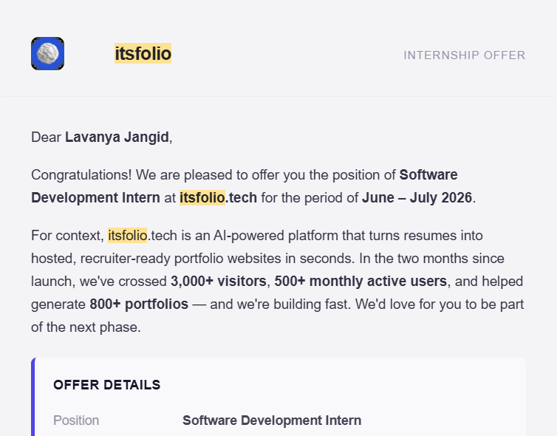
Internship Offer Letter

Slide 13
Thank You!
Lavanya Jangid Roll No: 2410031445
School of Computer Science & Engineering IILM University, Greater Noida, U.P.

